Slide 1




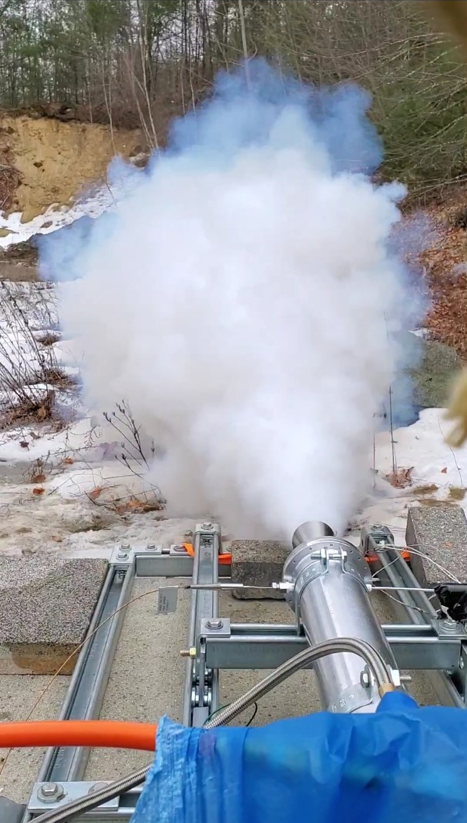
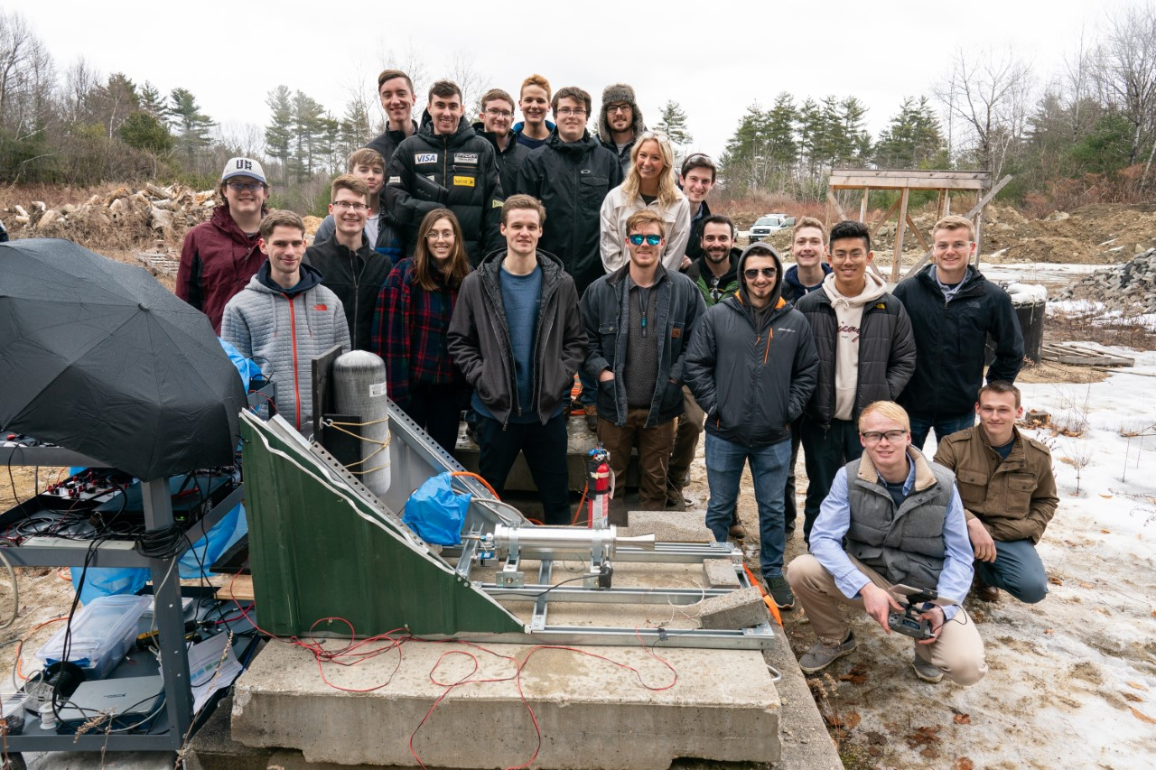
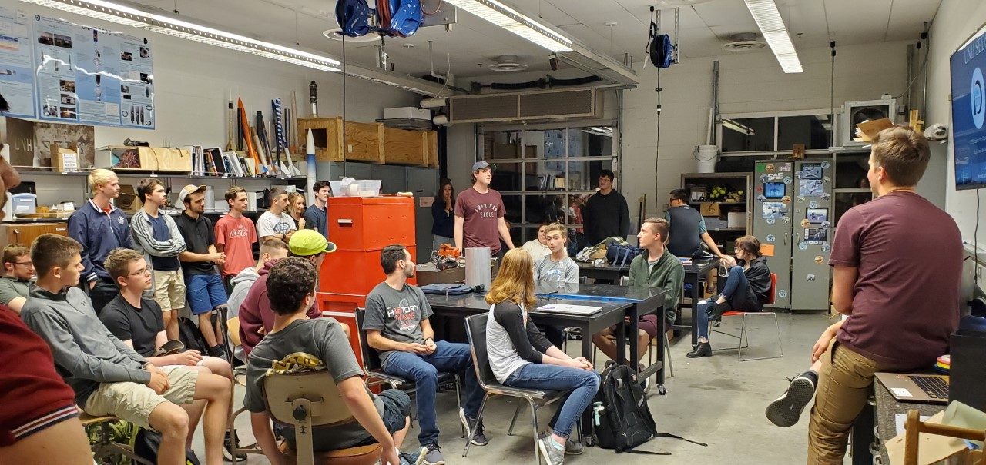
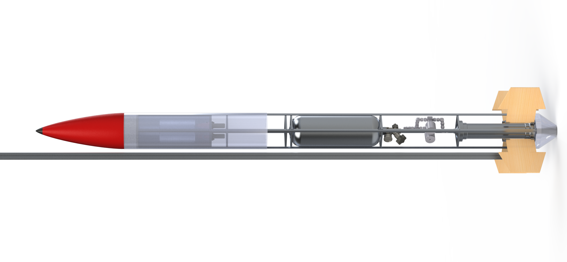
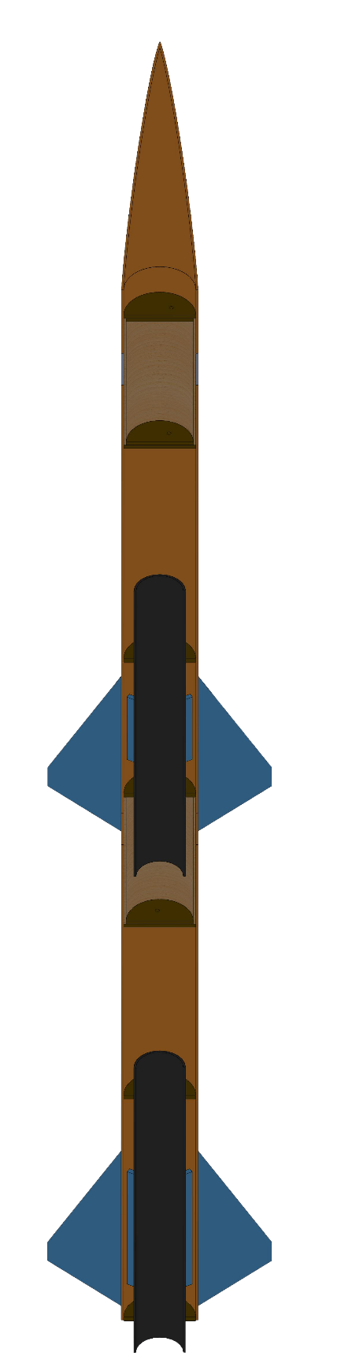


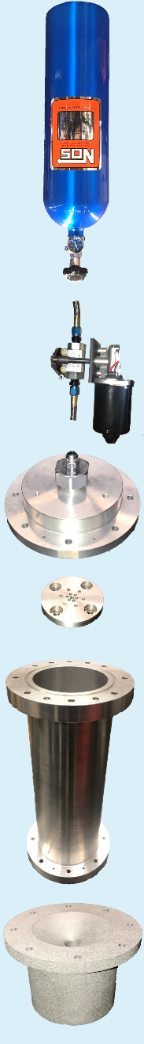
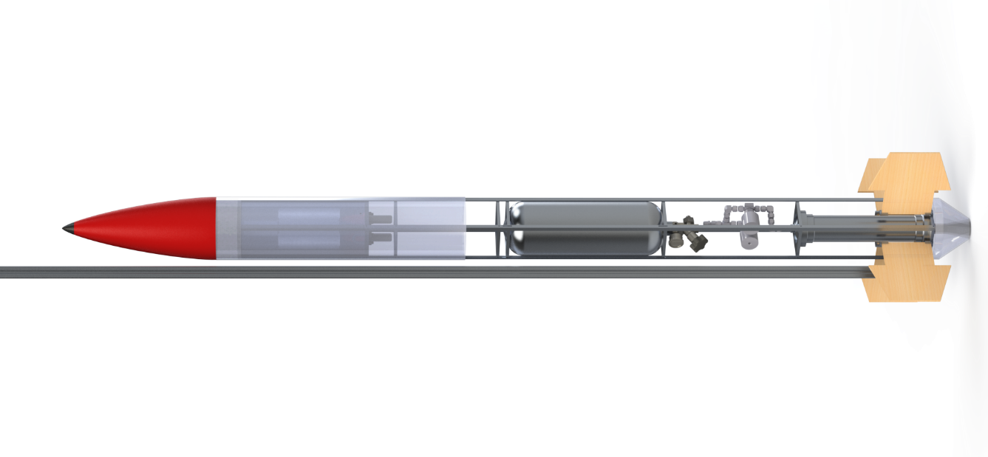
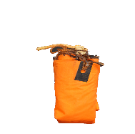
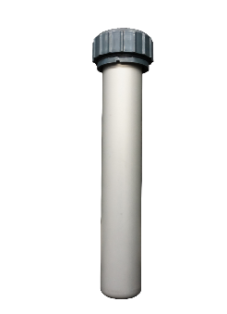


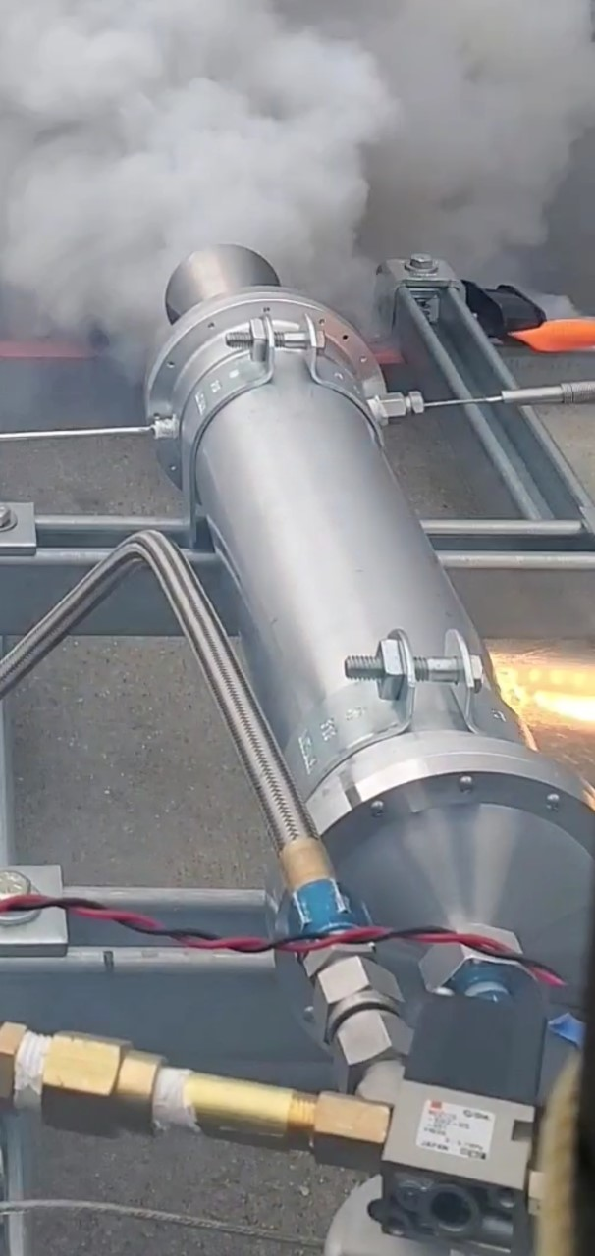
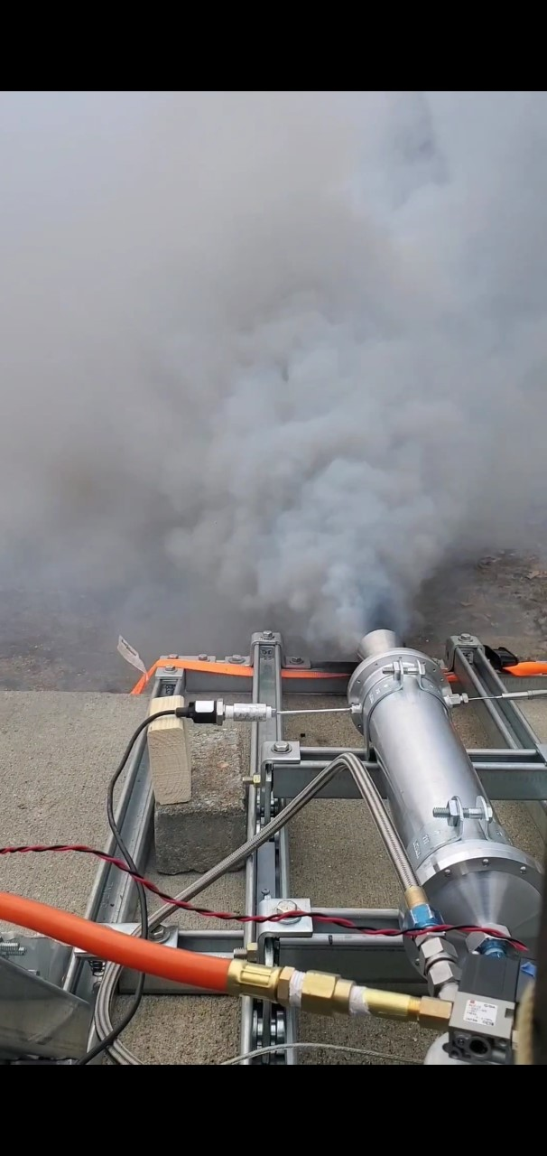
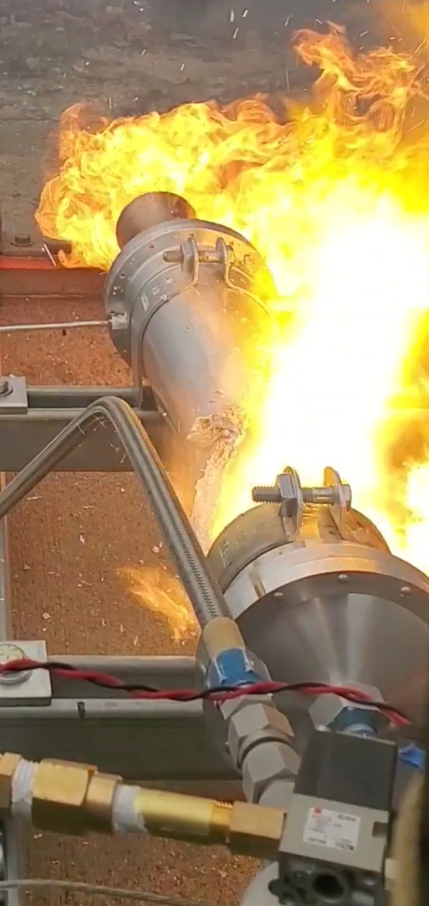
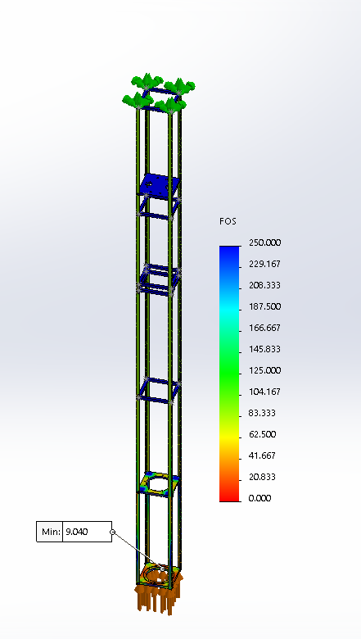
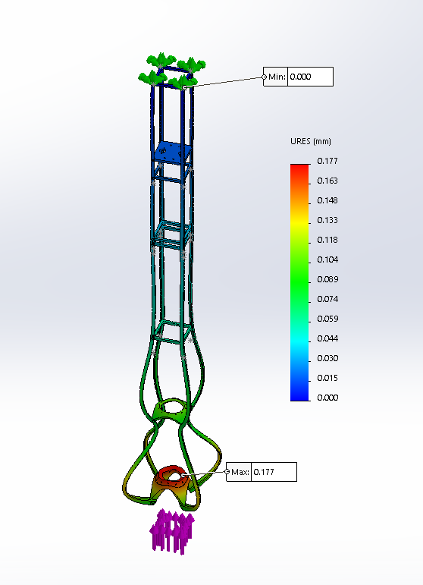

Department of Physics and Department of Mechanical Engineering
Author: Thomas Collins Advisor: Marc Lessard
Team Members: Charlie Nitschelm, Zachary Raboin, Silas Johnson, Lucas Simmonds, Carly Benik, Nathan Gunter, Darren Otten.
Who We Are
A third-year engineering organization comprised of students of all classes and CEPS majors
A primary engineering goal of pursuing the art of high-power rocketry with custom-made hybrid engines
Propulsion
On August 20th, 2019 UNH SEDS conducted its first hot fire of three hot fires for 2019-2020.
An unscheduled disassembly of the graphite nozzle led to inadequate data for analysis.
“V1”, utilized Hydroxyl-terminated polybutadiene (HTPB) and liquid nitrous oxide.
Stainless Steel was used in all further nozzle designs.
The initial use of Graphite was due to its ablative properties.
On March 6th, 2020 UNH SEDS conducted its second hot fire.
“V2”, utilized Paraffin wax and liquid nitrous oxide.
Maximum thrust of 25 lbf was recorded.
Specific impulse is a measure of how effectively a rocket uses propellant as fuel. We achieved an I_{sp}=177.12 sec
Our engine lacked the temperature and pressure required for stable combustion.
Nose Cone
The nose cone was 3D printed to an Ogival curve responsible for directing the flow of air outside of the rocket.
Nose Cone Tip
Aluminum was machined to the tip of an Ogival curve with a surface finish of 32 Ra. Vital to minimizing drag at the most critical point on the rocket.
Recovery Bay
Responsible for the recovery of the rocket via dual stage deployment. Raptor CO2 cartridges are used as stored internal energy devices.
Hot fire Test, March 2020
SEDS General Meeting, Spring 2020
Electronics Bay
An enclosed volume where the electronics of the rocket are stored. A combination Raspberry pi’s, Arduino’s and an Altus Metrum Telemega are used.
The 3 Year Plan
Year One
Hybrid Engine
Design
Manufacture
Cold / Hot fire test
Year Three
Payload Bay
An enclosed volume where the payload is contained. This payload can be a measurement device or dead-weight.
March 6th, 2020 hot fire test
Oxidizer Tank
A highly pressurized vessel that
contains liquid Nitrous Oxide,
acting as our oxidizer within
the combustion chamber
Flow Regulator
A solenoid valve that controls flow of the oxidizer into the injection plate. Flow regulation can also be used to vent the rocket fuel incase of an emergency.
Rocket Building
Simulating
Launching
Optimizing
Hybrid Rocket
Engine Optimization
Rocket Integration
Injection Plate
Responsible for providing desired oxidizer flow into the combustion chamber with the assistance of the impinging plate
Combustion Chamber
An enclosed volume where the solid reducer and liquid oxidizer react to produce a superheated, highly pressurized chamber of gas
Year Two
Frame Design
Fins
An enclosed volume where the solid reducer and liquid oxidizer react to produce a superheated, highly pressurized chamber of gas
Nozzle
Stainless Steel Nozzle was machined at Seneca Machining. This geometry is responsible for directing the flow of hot gases outside of the combustion chamber into the environment providing thrust.
Taped Base
The Taped Base helps to reduce the aerodynamic base drag on the aft portion of the rocket.
Moment of chamber breach
March 20th, 2020 hot fire test
Aluminum and Paraffin fire
On March 12th, 2020 UNH SEDS conducted its third hot fire.
“V2”, utilized Paraffin wax with 0.05% by weight Ferrocene Catalyst and liquid nitrous oxide.
Changes made since March 6th hot fire:
A reduction in nozzle throat diameter was made to increase chamber pressure.
An improved ignition system was used to increase chamber temperature prior to nitrous flow.
Maximum thrust of 45 lbf and an I_{sp}=318.522 sec was recorded.
Inconsistences in fuel grain led to a breach of the combustion chamber.
Current and Future Work
Re-design of the rocket body around a reduced diameter Oxidizer tank.
Optimum design of “V2” combustion chamber and nozzle.
Integrate thrust vectoring system onto the propulsion system
Further development into rocket payload, onboard or deployable instrumentation for Spaceport America Cup Competition.
Continuation of UNH SEDS within the CEPS community.
Factor of Safety: 200lbf applied to combustion chamber region of structure with fixed top.
Displacement: 200lbf applied to combustion chamber region of structure with fixed top.
The structural frame will act as the “house” for all components, to incorporate, propulsion, avionics, and recovery. The design of our rocket frame is centered around cost, manufacturability, weight, strength, and availability. A minimum FOS of 9.04 and maximum displacement of 0.177 mm was seen for an applied force of 200 lbf.
Acknowledgments
A huge thanks to all the members of UNH SEDS, Scott Campbell, Ronald O’Keefe, Dr. Ivo Nedyalkov, Dr. Alireza Ebadi, Sheldon Parent, James Abare, Andy Globe, Dave Emanuel, Adam Smith, Chief Dean, TURBOCAM International, Reilly Webb, Seneca Machining, the UNH Makerspace and our Mechanical Engineering advisor Dr. Todd Gross for all the support

Slide 2
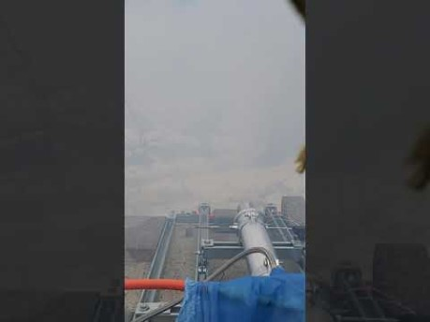

Slide 3
